Slide 1
Personal loan campaign Project
Sandhya Nair
January 2021

Slide 2
Objective
To predict whether a liability customer will buy a personal loan or not.
Which variables are most significant.
Which segment of customers should be targeted more.

Slide 3
Data Information
The data contains information about banks customers.
Variable | Description
ID
Age | Customer’s age
Experience | #years of professional experience
Income | Annual income of the customer (in thousand dollars)
ZIP Code | Home Address ZIP code.
Family | the Family size of the customer
Observations | Variables
5000 | 14

Slide 4
Data Information
.
CCAvg | Avg. spending on credit cards per month
Education | 1: Undergrad; 2: Graduate;3: Advanced/Professional
Mortgage | Value of house mortgage if any
Personal_Loan | Did this customer accept the personal loan offered in the last campaign?
Securities_Account | Does the customer have securities account with the bank?
CD_Account: | Does the customer have a certificate of deposit (CD) account with the bank?
Online | Do customers use internet banking facilities?
CreditCard | Does the customer use a credit card issued by Universal Bank?

Slide 5
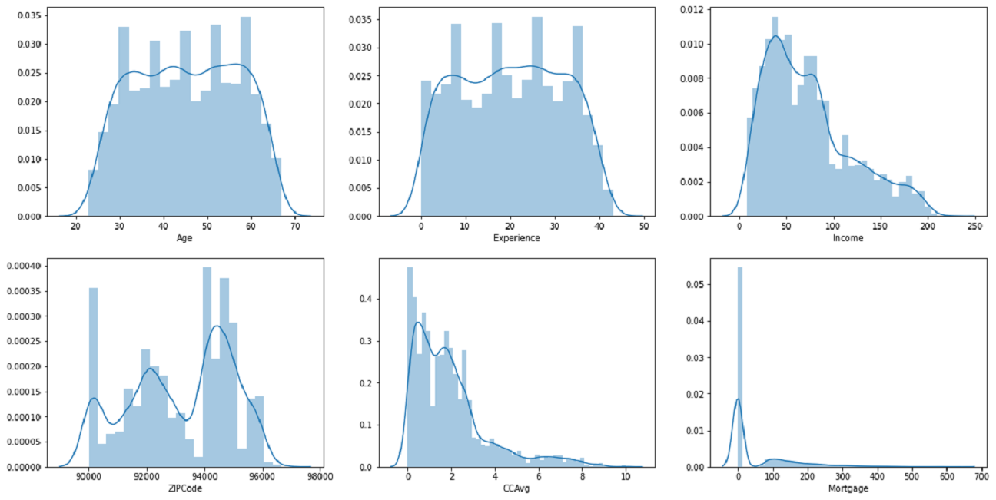
Exploratory Data Analysis
Analysis of Age,Experience,Income,Zip code,CCAvg,Mortgage
We can see that Age and Experience are uniformly distributed
Income,CCAvg,Mortgage are positively skewed
Zip code is distributed across different regions
Mortgage contains mostly zeros

Slide 6
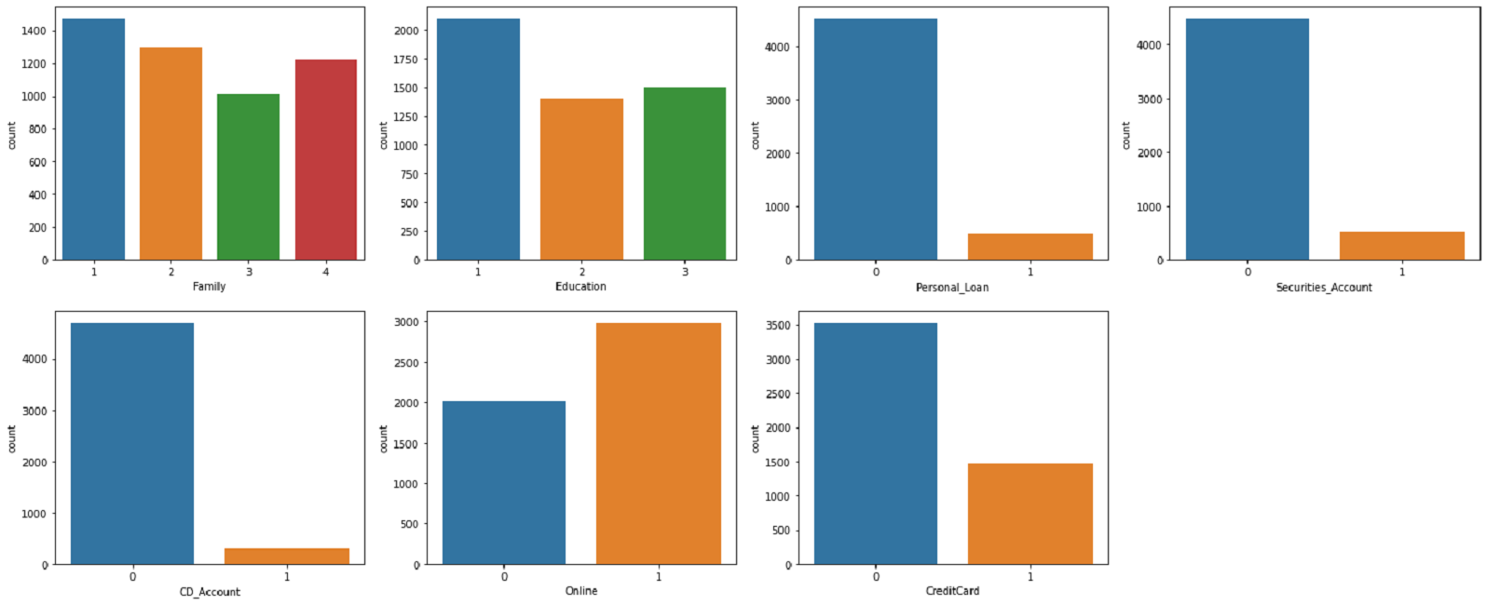
Exploratory Data Analysis
Analysis of Family,Education,Personal Loan,Securities & CD accounts,Online Accts & Credit Cards
Most of the customers are Undergrads and have family size one
Only a few customers have availed the personal loan in the previous campaign
Majority of the customers do not have a Securities_Account,CD_Account and Credit Card
Majority of customers use internet banking facilities

Slide 7
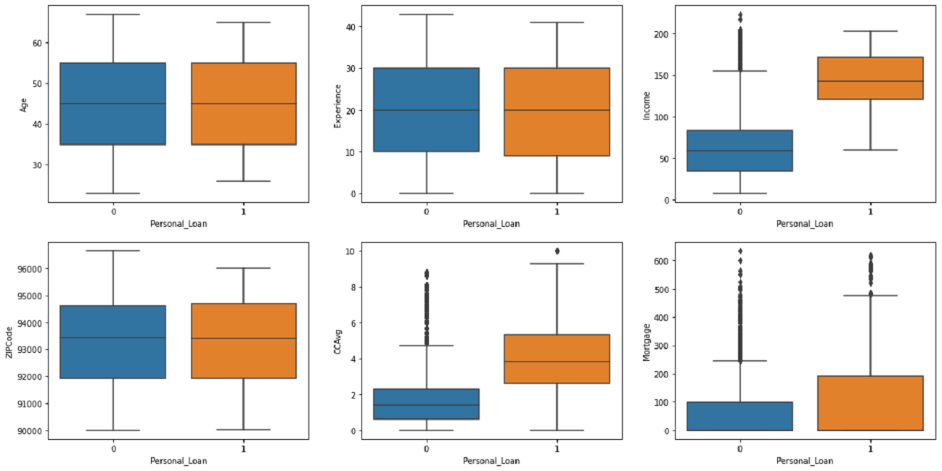
Exploratory Data Analysis
Analysis of Personal Loan with Age,Experience,Income,Zip code,CCAvg,Mortgage
We can see that there is not much variation in the Age and Experience of the customers who are availing personal_loan.That means customers of all ages and with different years of experience are equally availing the loans
We can see that customers having higher Income have better chances of accepting the loan offered
Customers having higher spending on Credit cards have availed loans
Customers from all most of the zip codes have availed loans.So its not concentrated in a single region

Slide 8
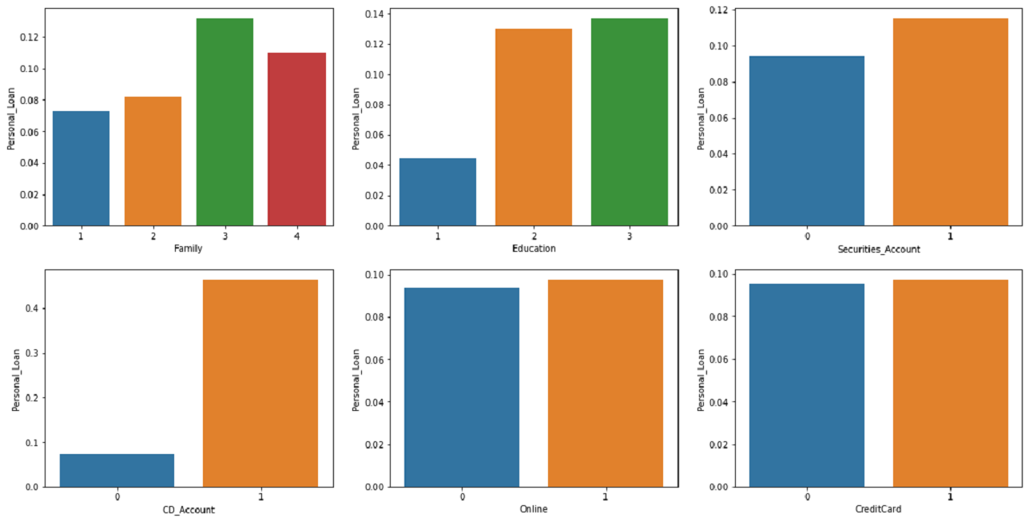
Exploratory Data Analysis
Analysis of Personal Loan with Family,Education,Personal Loan,Securities & CD accounts,Online Accts & Credit Cards
Family having 3 members have better chances of availing the loan when offered
Customers who are having graduate and Advanced/Professional degree have better chance of accepting the loan than customers who are undergraduates
Customers who have Securities_Account and CD_Accounts have more chance of accepting the personal loan
Using Internet banking or having a credit card does not increase the chance of accepting personal loan

Slide 9
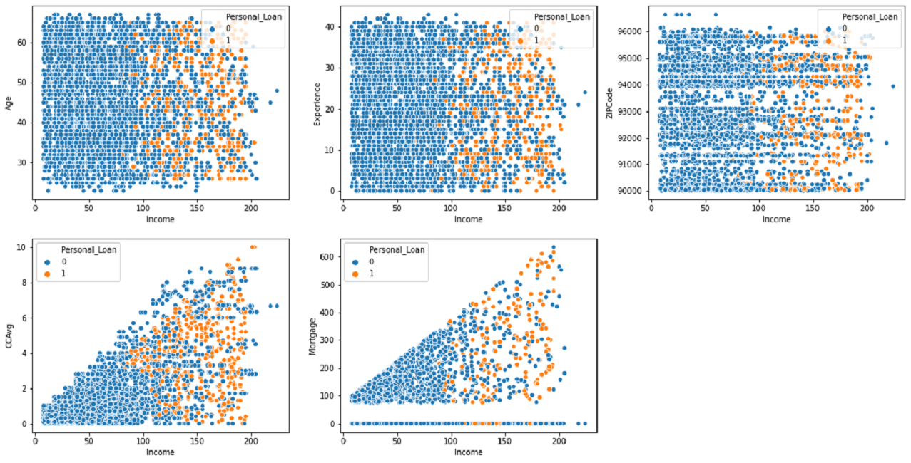
Exploratory Data Analysis
Analysis of Income with Age,Experience,Zip code,CCAvg,Mortgage
No of years of experience ,Age and zip code wrt Income show similar patterns for customers who has availed personal loan or not
Customers with high CCAVG spending seems to have accepted loan offer
Customers with higher mortgage values also have accepted loan offer

Slide 10
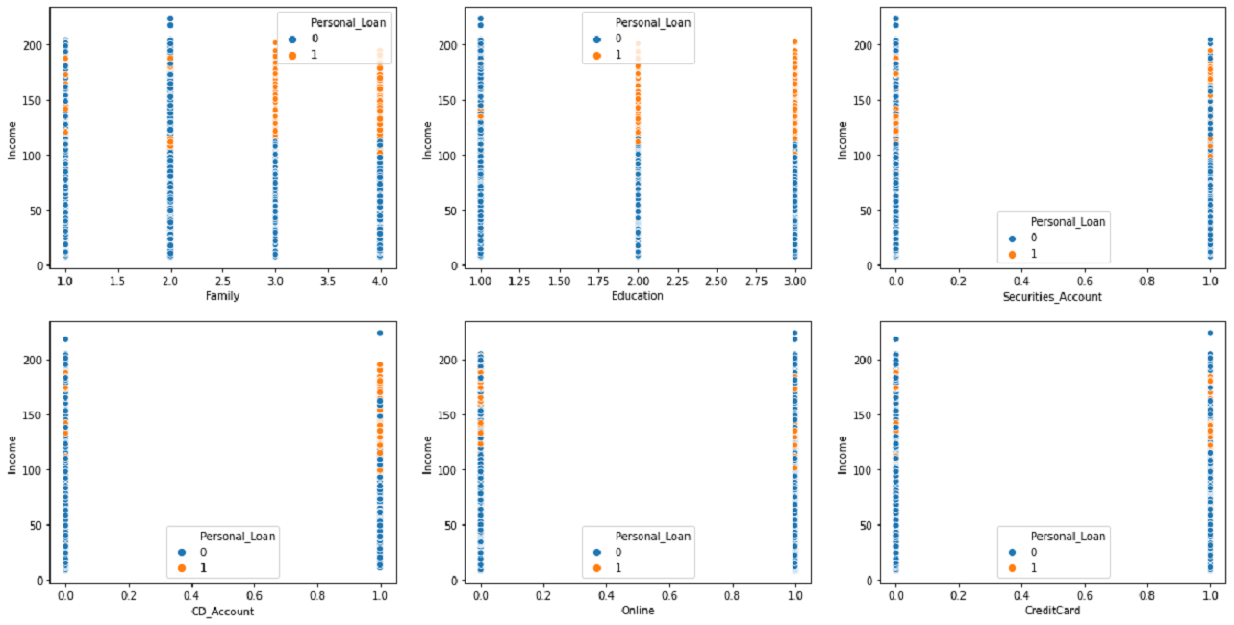
Exploratory Data Analysis
Analysis of Income with Family,Education,Securities_Account,CD_Account,Online and Credit Cards
We can see some outliers w.r.t to income for customers who are undergraduates

Slide 11
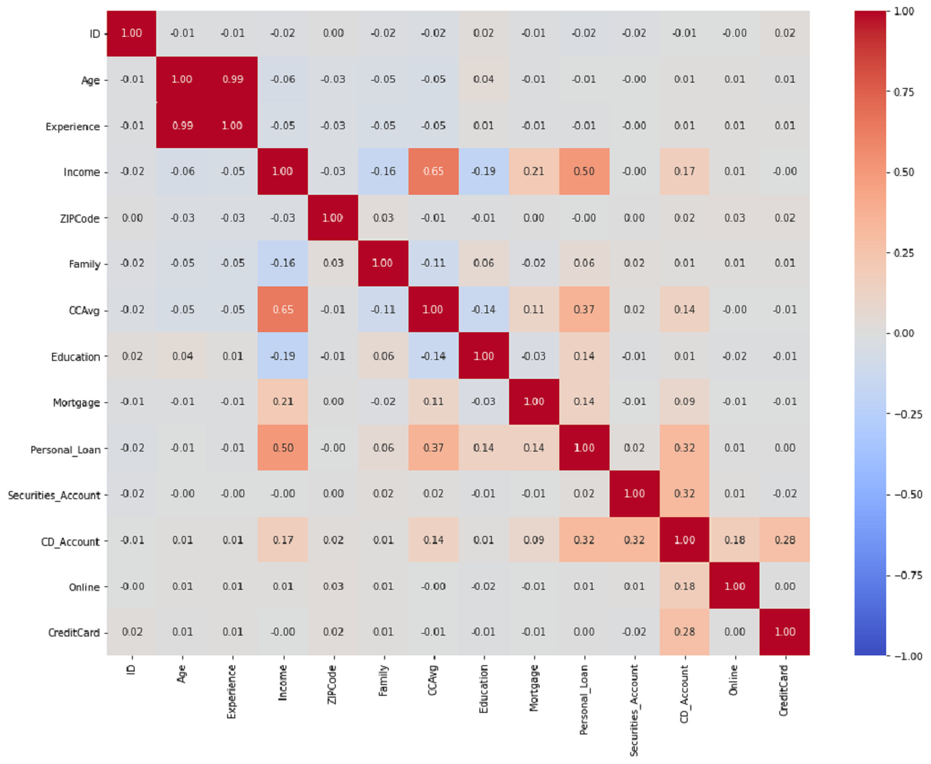
Exploratory Data Analysis:Correlation
Age and Experience are highly correlated
with each other .We would need to
remove one of these variables from
our model.
Personal_Loan has positive correlation
with Income & CCAvg
Also CCAvg & Income have positive
correlation with each other.

Slide 12
Insights Based on EDA
We can see that there is not much variation in the Age and Experience of the customers who are availing personal_loan.That means customers of all ages and with different years of experience are equally availing the loans
We can see that customers having higher Income have better chances of accepting the loan offered
Customers having higher spending on Credit cards have availed loans
Family having 3 members have better chances of availing the loan when offered
Customers who are having graduate and Advanced/Professional degree have better chance of accepting the loan than customers who are undergraduates
Customers who have Securities_Account and CD_Accounts have more chance of accepting the personal loan offered
Using Internet banking or having a credit card does not increase the chance of accepting personal loan offered
Customers with higher mortgage values also have accepted loan offer

Slide 13
Data Preprocessing
Experience Column:
Experience column had negative numbers.We did an analysis of No of years of experience with the age of the customers and determined that based on the age of the customers it would be ideal to just remove the - sign in front of the number.
Feature Engineering Income Column:
For the Income column we decided to split the customers based on their income into 3 categories :Low Income, Median Income & High Income since we identified that Income is an important variable from our exploratory data analysis.This classification of income variable will help us to build a better model for prediction
Feature Engineering CCAvg column:
For the CCAvg column we decided to split the customers based on their average credit card spending into 3 categories :Low Spending, Median Spending & High Spending since we identified that average CC spending is an important variable from our exploratory data analysis.This classification of CCAvg variable will help us to build a better model for prediction
Missing Values,duplicates and outliers
There are no missing or duplicates values in any columns
Income,CCAvg and Mortgage had upper outliers.Based on analysis of these variables we have decided not to treat them

Slide 14
Logistic Model Building
Encode Categorical features & Identify dependent variable:Before we proceed to modelling, we'll have to encode categorical features and we have identified Personal_Loan as the predictor variable
Partition the data into train and test set:We'll split the data into train and test, to be able to evaluate the performance of the model that we build on the train data.
Model Building:Built a Logistic regression model on the train data.
Remove multicollinearity and insignificant variables
Choose optimal threshold, if required.
Test the data on test set.
Model Evaluation Criterion
What does a bank want? Bank could face 2 types of situations
1. Target customers who do not end up taking Personal Loans - Loss of resources
2. Not targeting potential customers who may take Personal Loan - Loss of opportunity to earn more through interest on Loans
Which Loss is greater ?
Not targeting potential customers who may take Personal Loan i.e. False Negatives i.e Predicting a customer will not take loan, while in actual the customer will take the loan Since we want to reduce loss of opportunity, we should use Recall as a metric of model evaluation
Recall - It gives the ratio of True positives to Actual positives, so high Recall implies low false negatives, i.e. low chances of not targeting customers who may take loan

Slide 15
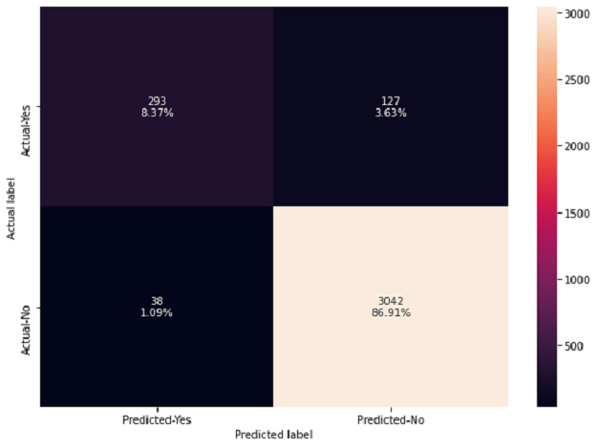
Model Performance Evaluation-Insights
True Positives:
Reality: A customer opted to take personal Loan. Model predicted: The customer will take personal loan. Outcome: The model is good.
True Negatives:
Reality: A customer opted out to take personal loan. Model predicted: The customer will not take personal loan. Outcome: The business is unaffected.
False Positives :
Reality: A customer opted out to take personal loan. Model predicted:
The customer will take personal loan. Outcome: The team which
is targeting the potential customers will be wasting their resources
on the people/customers who will not be availing a personal loan.
False Negatives:
Reality: A customer opted to take personal Loan. Model predicted:
The customer will not take personal loan.
Outcome: The potential customer is missed by the sales/marketing team, the team could have offered the potential customer some offer to make the customer to avail the personal loan.

Slide 16
Right Metrics to use and Observations
Right Metric to use:
In this case, not being able to identify a potential customer is the biggest loss we can face. Hence, recall is the right metric to check the performance of the model.
Observation
After choosing optimal threshold(0.144), true positives has increased from 6.53% to 8.37% while False Positive has decreased from 3.40%
The accuracy on test data is 93.6% & Recall is 83.2% after removing multicollinearity and choosing optimal threshold. This is more reliable as multi collinearity has been removed from the data.
AUC is 0.97

Slide 17
Decision Tree Model Building
Approach:
Data preparation
Partition the data into train and test set.
Built a CART model on the train data.
Tune the model and prune the tree, if required.
Test the data on test set.
We will use Recall as our metric for Model Evaluation
The Recall obtained after building a general tree for train and test are as follows:
Recall on training set : 1.0
Recall on test set : 0.6912751677852349
There is a huge disparity in performance of model on training set and test set, which suggests that the model is over fitting.

Slide 18
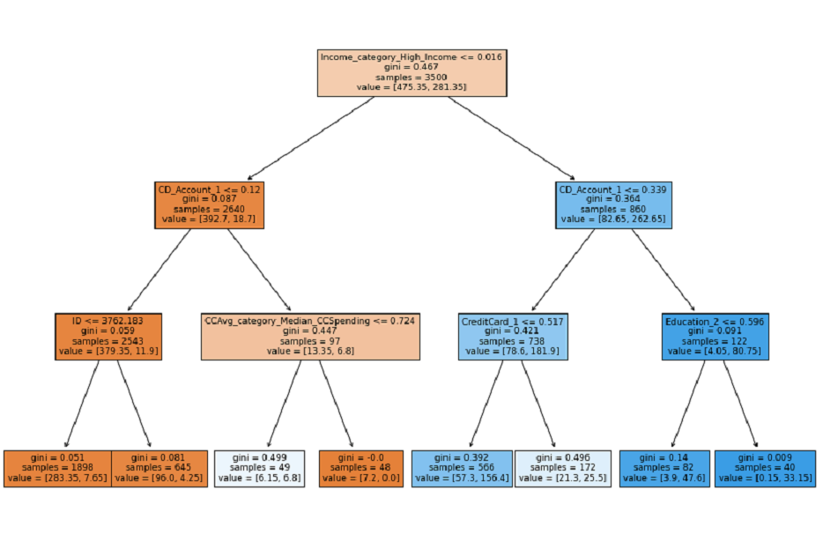
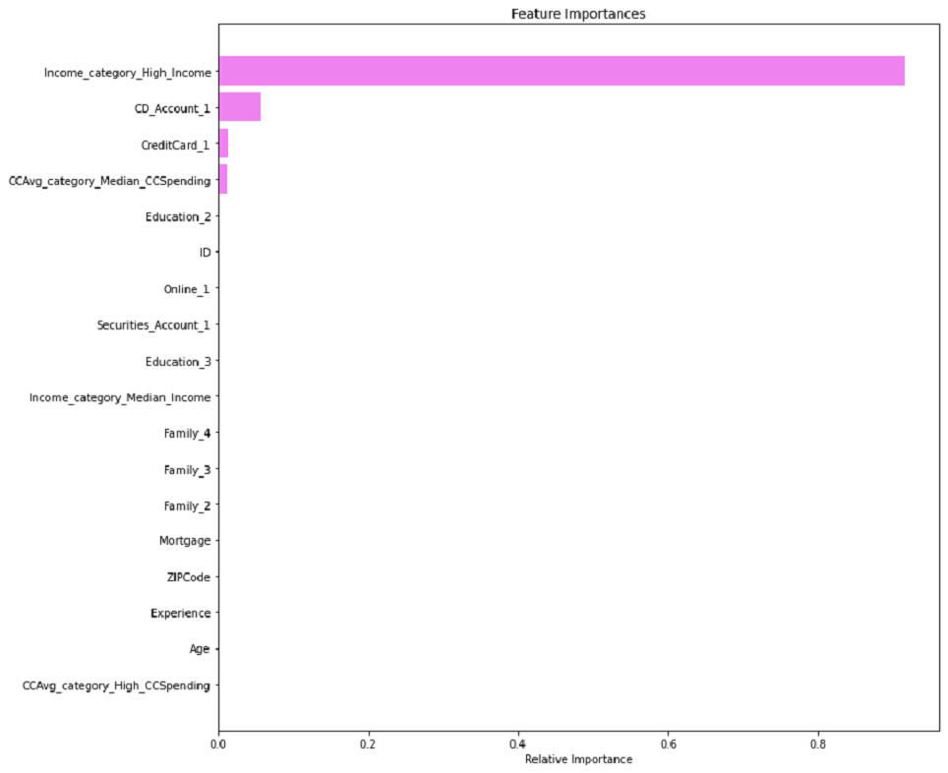
Decision Tree with Hyperparameter Tuning
Recall on training set : 0.95
Recall on test set : 0.93
Recall has improved for both train and test set after hyperparameter tuning and we have a generalized model.
Important Features after hyper parameter tuning are Income_High_category,CD_Account,Credit_Card & Median spending on CCavg

Slide 19
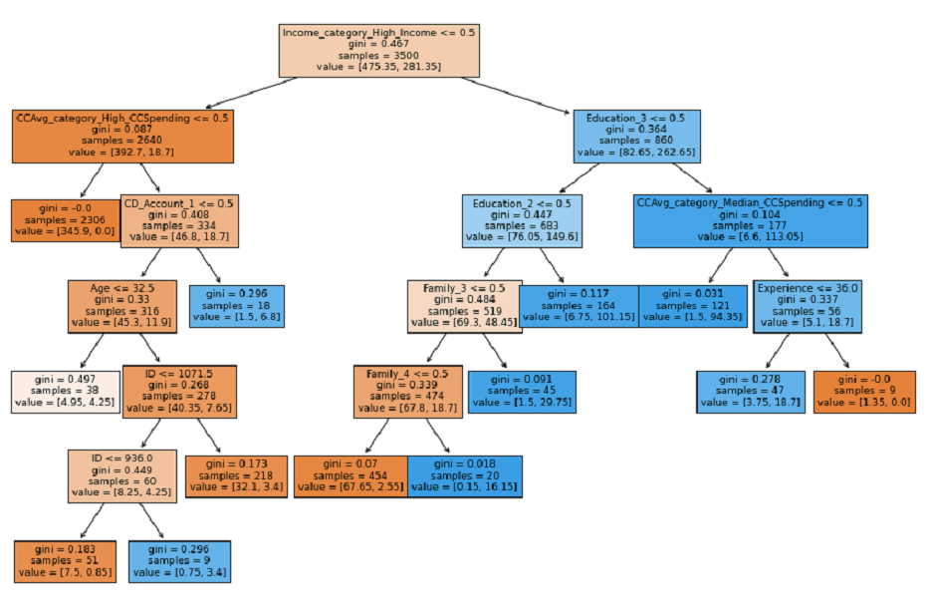
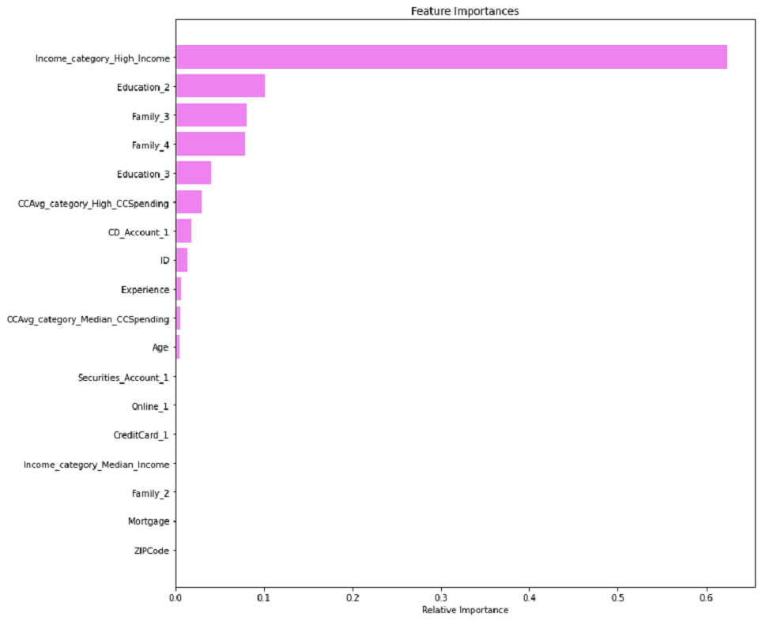
Cost Complexity Pruning(Post Pruning)
Recall on training set : 0.9607250755287009
Recall on test set : 0.912751677852349
Important Features from cost complexity pruning are High_Income,Graduate Education,Family with 3 & 4 members,high CC Avg spending

Slide 20
Model Comparison
Model | Train Recall | Test Recall
Logistic Regression | 0.88 | 0.83
Initial Decision Tree model | 1.00 | 0.69
Decision Tree with Hyperparameter Tuning | 0.95 | 0.93
Decision Tree with Post Pruning | 0.96 | 0.91

Slide 21
Conclusion
We analyzed the Personal Loan campaign data using Exploratory Data Analysis and by using different models like Logistic Regression and Decision Tree Classifier to build a predictive model for the same.
The model built can be used to predict if a customer is going to purchase a loan or not and thus the Bank can earn more through Interest on Loans.
First We built a Logistic Regression model and analyzed the model performance on the Recall criteria.Through this model built we got to know that some of the important features for prediction was Income, CD_Account, Education, CCAvg, Family.We also analyzed the AUC ROC curve for the model
Next We visualized different trees and their confusion matrix to get a better understanding of the model. Easy interpretation is one of the key benefits of Decision Trees.
We verified the fact that how much less data preparation is needed for Decision Trees and such a simple model gave good results even with outliers and imbalanced classes which shows the robustness of Decision Trees.
High Income,Customers with graduate degree, customers having 3 family members, high CCAvg spending are some of the most important variables in predicting if the customers will purchase a personal loan.
We established the importance of hyper-parameters/ pruning to reduce overfitting

Slide 22
Recommendations
According to the decision tree model if a customer falls into a High Income category, there is high chance that the customer will avail Personal Loan when offered.
Also customers who are graduates has a high chance of purchasing the Personal Loan.
If the customer has family size of 3 members those should be targeted for offering Personal Loan and there are high chances that they will purchase the loan
Also need to target customer who has high Avg CC spending .These customers also show a high chance of purchasing the personal loan when offered.
Other customers who can be targeted that has a fairly good chance of purchasing the personal loan are customers who have Advanced/Professional degree, those who have a CD_Account and also customers who has 4 family members.
Customer who does not show possibly of purchasing personal loans are those having medium to low income.
Customer having small families like 1 or 2 members does not have much chance of purchasing personal loan.
Also having an online or Credit Card is not contributing to the chances of purchasing personal loans

